Slide 1
Chapter 4:
The Enhanced E-R Model and
Business Rules
Modern Database Management
6th Edition
Jeffrey A. Hoffer, Mary B. Prescott, Fred R. McFadden

Slide 2
Supertypes and Subtypes
Subtype: A subgrouping of the entities in an entity type which has attributes that are distinct from those in other subgroupings
Supertype: An generic entity type that has a relationship with one or more subtypes
Inheritance:
  Subtype entities inherit values of all attributes of the supertype
  An instance of a subtype is also an instance of the supertype

Slide 3
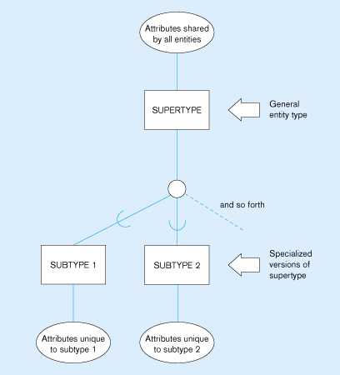
Figure 4-1
Basic notation for supertype/subtype relationships

Slide 4
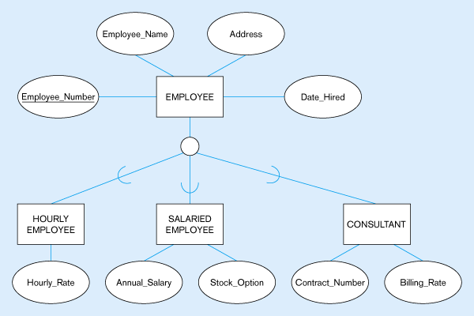
Figure 4-2 -- Employee supertype with three subtypes
All employee subtypes will have emp nbr, name, address, and date-hired
Each employee subtype will also have its own attributes

Slide 5
Relationships and Subtypes
Relationships at the supertype level indicate that all subtypes will participate in the relationship
The instances of a subtype may participate in a relationship unique to that subtype. In this situation, the relationship is shown at the subtype level

Slide 6
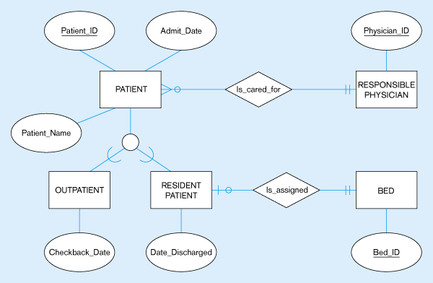
Figure 4-3 -- Supertype/subtype relationships in a hospital
Both outpatients and resident patients are cared for by a responsible physician
Only resident patients are assigned to a bed

Slide 7
Generalization and Specialization
Generalization: The process of defining a more general entity type from a set of more specialized entity types. BOTTOM-UP
Specialization: The process of defining one or more subtypes of the supertype, and forming supertype/subtype relationships. TOP-DOWN

Slide 8
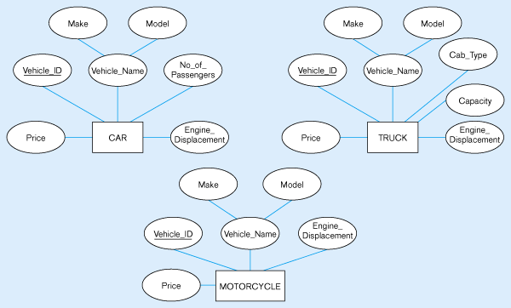
Figure 4-4 – Example of generalization
(a) Three entity types: CAR, TRUCK, and MOTORCYCLE
All these types of vehicles have common attributes

Slide 9
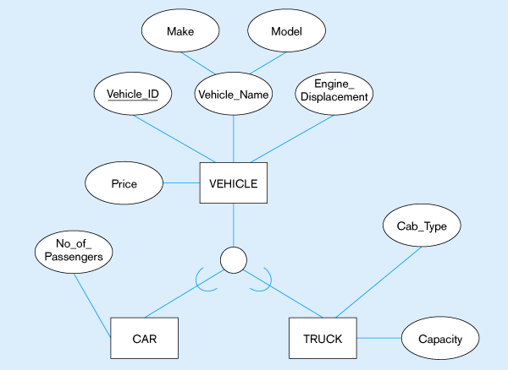
Figure 4-4(b) – Generalization to VEHICLE supertype
So we put the shared attributes in a supertype
Note: no subtype for motorcycle, since it has no unique attributes

Slide 10
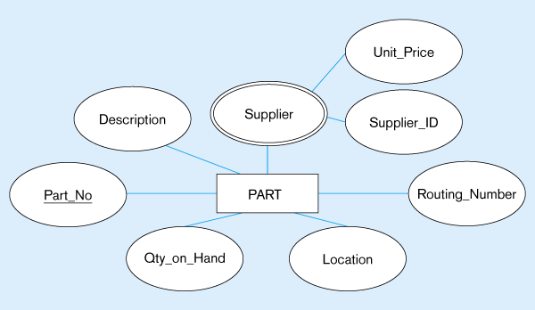
Figure 4-5 – Example of specialization
(a) Entity type PART
Applies only to purchased parts
Only applies to manufactured parts

Slide 11
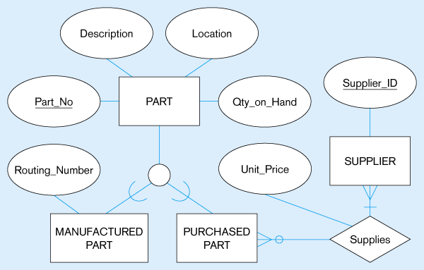
Figure 4-5(b) –
Specialization to MANUFACTURED PART and PURCHASED PART
Created 2 subtypes
Note: multivalued attribute was replaced by a relationship to another entity

Slide 12
Constraints in Supertype/ Completeness Constraint
Completeness Constraints: Whether an instance of a supertype must also be a member of at least one subtype
  Total Specialization Rule: Yes (double line)
  Partial Specialization Rule: No (single line)

Slide 13
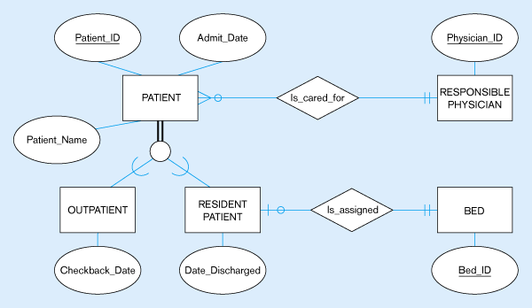
Figure 4-6 – Examples of completeness constraints
(a) Total specialization rule
A patient must be either an outpatient or a resident patient

Slide 14
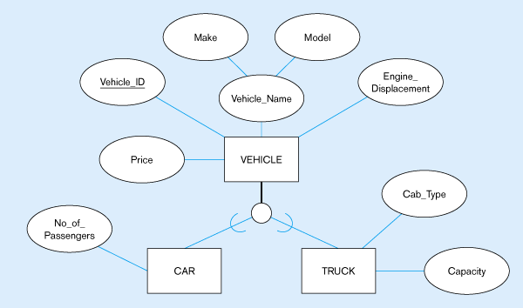
Figure 4-6(b) – Partial specialization rule
A vehicle could be a car, a truck, or neither

Slide 15
Constraints in Supertype/ Disjointness constraint
Disjointness Constraints: Whether an instance of a supertype may simultaneously be a member of two (or more) subtypes.
  Disjoint Rule: An instance of the supertype can be only ONE of the subtypes
  Overlap Rule: An instance of the supertype could be more than one of the subtypes

Slide 16
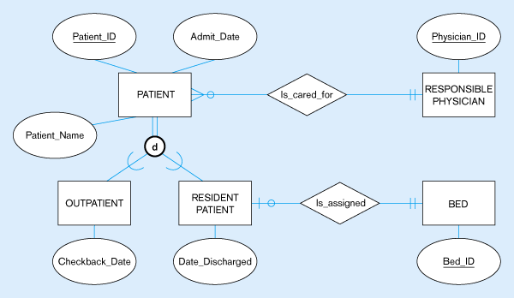
Figure 4-7 – Examples of disjointness constraints
(a) Disjoint rule
A patient can either be outpatient or resident, but not both

Slide 17
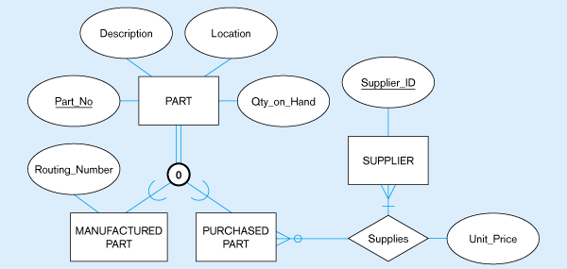
Figure 4-7(b) Overlap rule
A part may be both purchased and manufactured

Slide 18
Constraints in Supertype/ Subtype Discriminators
Subtype Discriminator: An attribute of the supertype whose values determine the target subtype(s)
  Disjoint – a simple attribute with alternative values to indicate the possible subtypes
  Overlapping – a composite attribute whose subparts pertain to different subtypes. Each subpart contains a boolean value to indicate whether or not the instance belongs to the associated subtype

Slide 19
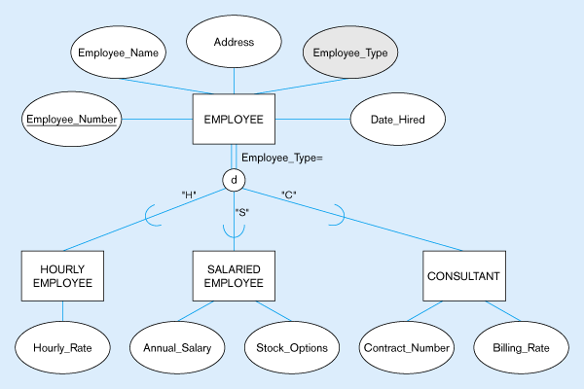
Figure 4-8 – Introducing a subtype discriminator (disjoint rule)
A simple attribute with different possible values indicating the subtype

Slide 20
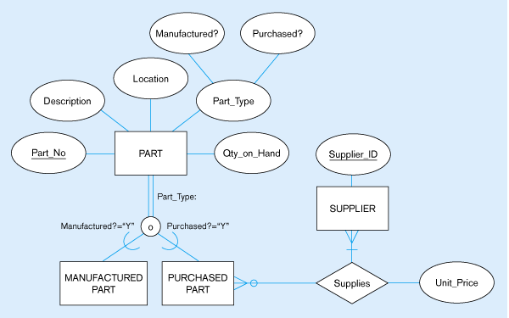
Figure 4-9 – Subtype discriminator (overlap rule)
A composite attribute with sub-attributes indicating “yes” or “no” to determine whether it is of each subtype

Slide 21
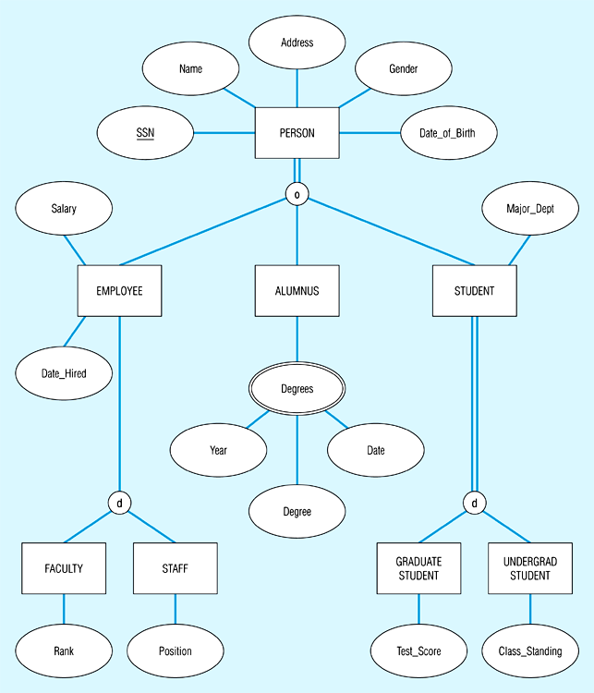
Figure 4-10 – Example of supertype/subtype hierarchy

Slide 22
Entity Clusters
EER diagrams are difficult to read when there are too many entities and relationships
Solution: group entities and relationships into entity clusters
Entity cluster: set of one or more entity types and associated relationships grouped into a single abstract entity type

Slide 23
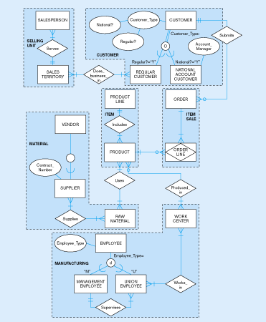
Figure 4-13(a) – Possible entity clusters for Pine Valley Furniture
Related groups of entities could become clusters

Slide 24
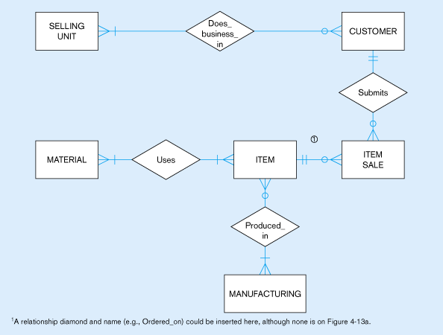
Figure 4-13(b) – EER diagram of PVF entity clusters
More readable, isn’t it?

Slide 25
Business rules
Statements that define or constrain some aspect of the business.
Constraints can impact:
  Structure (definition, domain, relationship)
  Behavior (operational constraints)
Classification of business rules:
  Derivation – rule derived from other knowledge
  Structural assertion – rule expressing static structure
  Action assertion – rule expressing constraints/control of organizational actions

Slide 26
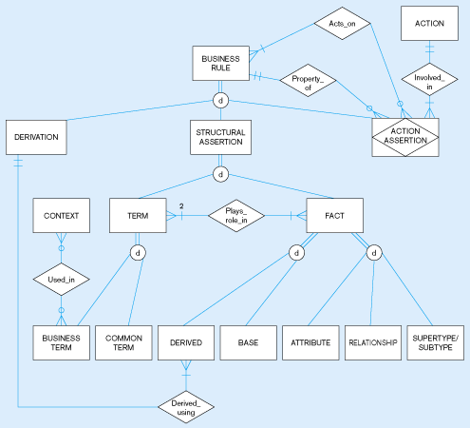
Figure 4-15 – EER depiction of business rules classification
Source: adapted from GUIDE Business Rules Project, 1997.

Slide 27
Action Assertion Classifications
Result
  Condition – IF/THEN rule
  Integrity constraint – must always be true
  Authorization – privilege statement
Form
  Enabler – leads to creation of new object
  Timer – allows or disallows an action
  Executive – executes one or more actions
Rigor
  Controlling – something must or must not happen
  Influencing – guideline for which a notification must occur

Slide 28
Stating an Action Assertion
Anchor Object – an object on which actions are limited
Action – creation, deletion, update, or read
Corresponding Objects – an object influencing the ability to perform an action on another business rule
Action assertion will identify corresponding objects that constrain the ability to perform actions on anchor objects

Slide 29
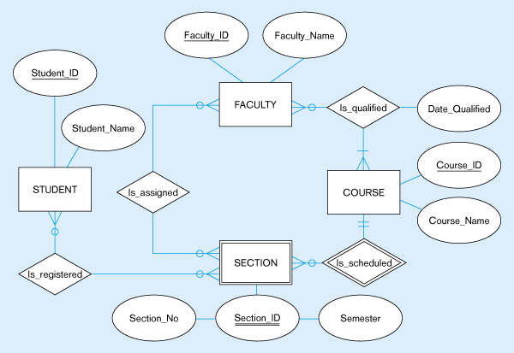
Figure 4-16 – Data model segment for class scheduling

Slide 30
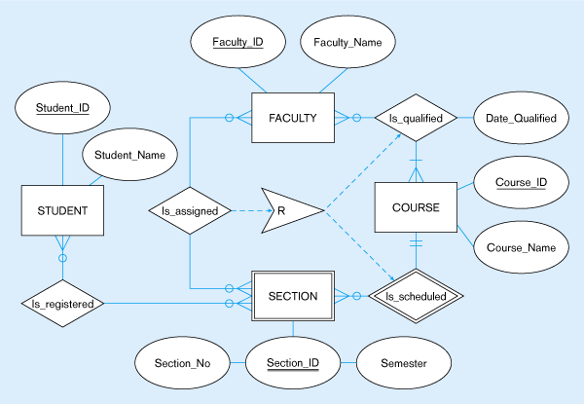
Figure 4-17 – Business Rule 1: For a faculty member to be assigned to teach a section of a course, the faculty member must be qualified to teach the course for which that section is scheduled
Corresponding object
In this case, the action assertion is a Restriction
Action assertion
Anchor object
Corresponding object

Slide 31
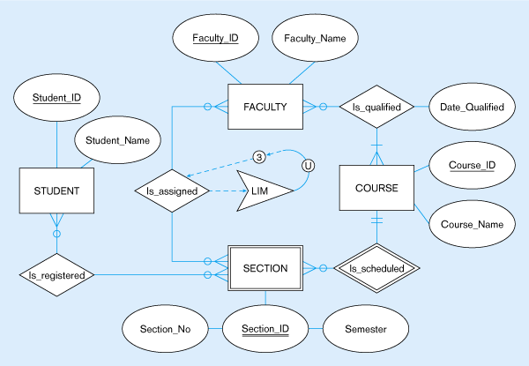
Figure 4-18 –Business Rule 2: For a faculty member to be assigned to teach a section of a course, the faculty member must not be assigned to teach a total of more than three course sections
In this case, the action assertion is an
Upper LIMit
Corresponding object
Anchor object
Action assertion

